Slide 1


Mid Review Presentation [Group 29]
Thermal - Carbon Aware Dynamic Scheduling in Kubernetes for Reduced Grid and Facility-level Emissions.
Presented by
Aakhil Subair | AM.SC.U4AIE23101
Jaydeep Dileep | AM.SC.U4AIE23114
KR Karthik | AM.SC.U4AIE23116
Under the supervision of
Dr. Reshma Raj R.S.
Department of Computer Science & Engineering

Slide 2
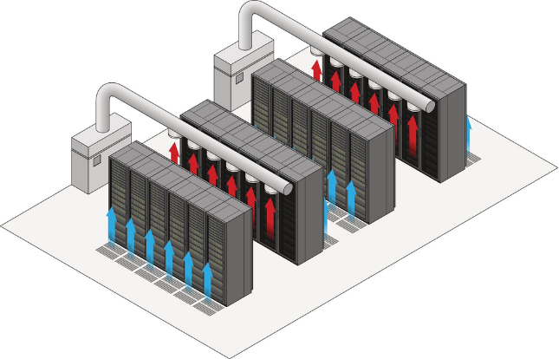
BACKGROUND AND MOTIVATION
THE HIDDEN ENVIRONMENTAL COST OF DATACENTERS
GLOBAL POWER DEMAND
Global data center electricity usage exceeded 200 TWh in 2022 and is projected to surpass 1,000 TWh by 2030, driven heavily by continuous AI and LLM workloads.
ELECTRICITY CARBON INTENSITY VARIATION BY TIME AND REGION
The carbon footprint of electricity — measured in gCO₂/kWh — is powered by different sources — sometimes solar or wind (clean), sometimes coal or gas (dirty). Despite this variation, current cloud scheduling systems treat all electricity as equivalent and make no attempt to prefer cleaner power windows.
RUNNING TASKS ALSO OVERHEATS THE MACHINES
When compute-intensive workloads run on already-loaded servers, they heat up. To cool them down, data centres run heavy-duty cooling systems — which burns even more electricity. This cancels out whatever energy savings we tried to achieve resulting in violation of SLO.

Slide 3
THE BLIND SPOT IN MODERN CLOUD SERVER
PROBLEM STATEMENT
1
THE CORE PROBLEM
Kubernetes schedules tasks based only on CPU, memory, and latency — never on electricity cleanliness.
It treats all compute nodes as environmentally identical, regardless of when or where they run.
Existing carbon-aware tools only shift work in time or location — they stop there.
None of them monitor node temperature, so cooling systems kick in and cancel out the savings.
AI workloads make this worse — they are heat-intensive and latency-sensitive at the same time.
A critical gap exists: No existing system simultaneously minimises grid-level carbon emissions, accounts for internal thermal overhead, and preserves the latency requirements of AI workloads. This project directly addresses that gap.
2
OUR APPROACH
Monitor live grid carbon intensity and predict the next 24 hours using an LSTM model.
Defer non-critical tasks to low-carbon time windows automatically.
Track node-level CPU temperatures in real time and route workloads away from hot nodes.
Dynamically reduce AI model precision when carbon or heat thresholds are exceeded.
Validate everything on a physical Raspberry Pi 5 K3s cluster — not in simulation.

Slide 4
EXISTING SYSTEM / LITERATURE REVIEW
1.
Piontek, Haghshenas & Aiello — "Carbon Emission-Aware Job Scheduling for Kubernetes Deployments"
3
Uses a custom Kubernetes scheduler with live Electricity Maps carbon data to schedule workloads during low-carbon periods.
Delays non-critical jobs to reduce carbon emissions while maintaining zero SLA violations.
Dataset Used: Historical grid-emission data (ElectricityMap traces) and virtualized SLA-constrained web server traces.
LIMITATIONS & FUTURE SCOPE:
Web Apps Only — No AI or ML Workload Support
Temporal Shifting Only — No Spatial Node Migration
Thermal Node Constraints Not Modeled in Scheduler
6
2.
Zhou, Chan, Zhang, Lin & Ni — "A Kubernetes Custom Scheduler Based on Reinforcement Learning"
Uses DQN-based Kubernetes schedulers to dynamically select nodes for compute-intensive workloads, reducing CPU utilization by 10–20% compared with the default scheduler.
Shows that reinforcement learning can significantly improve scheduling decisions without manual rule engineering, allowing the system to adapt to changing cluster conditions over time.
Dataset Used: Simulated compute-intensive ML training workloads in containers.
LIMITATIONS & FUTURE SCOPE:
8
No Carbon or Renewable Awareness
HPA Requires Custom Adapters
Ignores Node Thermal State in Scheduling Decisions

Slide 5
EXISTING SYSTEM / LITERATURE REVIEW
3.
Souza, Jasoria et al. — "CASPER: Carbon-Aware Scheduling and Provisioning for Distributed Web Services"
Uses multi-objective optimization to route web requests to regions with higher renewable energy availability.
Balances by achieving measurable carbon emissions without degrading latency, reducing emissions without affecting SLA performance.
Dataset Used: Production trace logs from geo-distributed web service instances.
LIMITATIONS & FUTURE SCOPE:
Data Gravity Limits Large-Scale Dataset Migration
Web Traffic Only — No Container-Granularity Scheduling
No Facility-Level Thermal or Cooling Overhead Modeled
4.
Zhang, Guo, Tan & Jiang — "CarbonEdge: Carbon-Aware Deep Learning Inference Framework for Sustainable Edge Computing"
Uses real-time carbon intensity to dynamically adjust AI model precision, reducing energy consumption during high-carbon periods while maintaining efficient edge inference.
Dataset Used: ImageNet ILSVRC2012 validation set; MobileNetV2, MobileNetV4, and EfficientNet-B0 model benchmarks.
LIMITATIONS & FUTURE SCOPE:
Quantization Degrades AI Accuracy Under Carbon Pressure
No Adaptive Threshold to Protect Mission-Critical AI
Single-Device Only — No Cluster-Level Kubernetes Orchestration

Slide 6
EXISTING SYSTEM / LITERATURE REVIEW
5.
Amaral et al. (IBM Research) — "Kepler: A Framework to Calculate the Energy Consumption of Containerized Applications"
Uses eBPF and hardware sensors to measure energy usage at the individual pod level with less than 5% overhead.
Provides accurate energy data for carbon- and thermal-aware Kubernetes scheduling.
Dataset Used: SPEC CPU benchmarks and synthetic Kubernetes cluster load traces.
LIMITATIONS & FUTURE SCOPE:
Hardware Counters Are Vendor-Specific (x86-Centric)
ARM and Edge Architecture Standardization Missing
Pod Energy Scores Not Linked to Grid Carbon Signals
6.
Sankiti, Punniyamoorthy et al. — "Cost-Effective Kubernetes at the Edge: K3s on Raspberry Pi versus Cloud Deployments"
Benchmarks K3s on Raspberry Pi 5 with Prometheus, Grafana, and Loki, showing that it is a low-cost and capable platform for Kubernetes scheduling experiments.
Dataset Used: K3s deployment logs plus Prometheus/Grafana/Loki telemetry on a Raspberry Pi 5 cluster.
LIMITATIONS & FUTURE SCOPE:
Thermal Throttling on Sustained High-Load Workloads
SD Card I/O Bottleneck for Heavy AI Dataset Workloads
No Carbon-Aware Scheduling Layer Evaluated or Proposed

Slide 7
RESEARCH GAPS & NOVELTY
SYSTEM/ PAPER | GRID CARBON AWARENESS | INTERNAL THERMAL AWARENESS | KUBERNETES ORCHESTRATION | DYNAMIC AI PRECISION SCALING | PHYSICAL EDGE VALIDATION | ENERGY-PER-POD MONITORING
Piontek et al. (2023) | ✔ | ✘ | ✔ | ✘ | ✘ | ✘
Zhou et al. (2026) | ✘ | ✔ | ✔ | ✘ | ✘ | ✘
Souza et al. (2023) | ✔ | ✘ | ✘ | ✘ | ✔ | ✘
Zhang et al. (2026) | ✔ | ✘ | ✘ | ✔ | ✘ | ✘
Amaral et al. (2023) | ✘ | ✔ | ✘ | ✘ | ✔ | ✔
Sankiti et al. (2025) | ✘ | ✘ | ✔ | ✘ | ✔ | ✘
Our Proposed System | ✔ | ✔ | ✔ | ✔ | ✔ | ✔

Slide 8
RESEARCH GAPS & NOVELTY
# | NOVELTY | CONTRIBUTION
1 | Carbon-Aware Smart Scheduling | Integrates live grid carbon intensity into Kubernetes to automatically defer non-critical workloads to low-carbon time windows — reducing emissions without violating SLAs.
2 | Dynamic AI Precision Scaling | Dynamically adjusts AI model precision at runtime based on real-time carbon intensity and thermal state, protecting accuracy SLAs while cutting energy consumption.
3 | Thermal-Aware Node Selection | Incorporates live CPU temperature readings alongside carbon signals to route workloads away from thermally stressed nodes, preventing throttling during inference.
4 | Validated on Real Edge Hardware | All experiments conducted on a physical Raspberry Pi 5 K3s cluster — not simulation — ensuring genuine real-world applicability and full reproducibility.

Slide 9
RESEARCH OBJECTIVES
RO1 : Carbon Telemetry and Forecasting Pipeline
RO2 : Unified Thermal-Carbon Kubernetes Scheduling Plugin
RO3 : Dynamic AI Precision Scaling Controller
RO4 : Physical Testbed Validation

Slide 10
DATASET / EXPERIMENTAL SETUP
DATASETS & LIVE API FEEDS
OWID & Ember Energy:
Source: https://ember-energy.org/data/yearly-electricity-data/
Size: >50,400 samples across 79 features
Usage: Training corpus for the LSTM carbon forecasting model after MinMax normalization and 24h sliding window preprocessing.
Electricity Maps API:
Source: https://app.electricitymaps.com/api/docs/quick-start#introduction
Data: Real-time regional carbon intensity (gCO2/kWh) and 24-hour forecast feed
Usage: Runtime scheduler input + LSTM validation feed for live MAPE computation
TECH STACK
· Orchestration: K3s
· Scheduling: Go (Backend)
· Telemetry: Kepler eBPF
· Monitoring: Prometheus + Grafana
· Storage: PostgreSQL
· ML: PyTorch + ONNX Runtime
· Workloads: Python
HARDWARE
Physical K3s Edge Cluster (Raspberry Pi)
All nodes run Raspberry Pi OS Lite (64-bit)
Thermal sensors: onboard SoC temperature sensors + vcgencmd interface

Slide 11
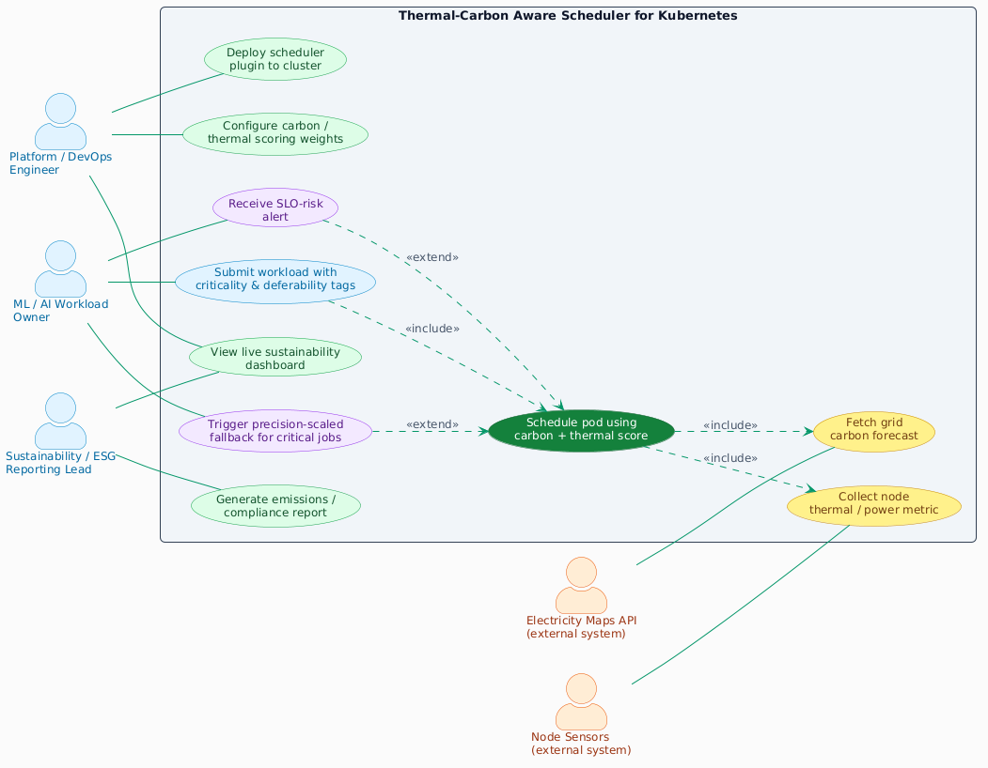
METHODOLOGY
Platform Engineer — deploys the scheduler plugin and configures carbon/thermal scoring weights.
ML / AI Workload Owner — submits jobs with a priority tag; the scheduler handles the rest automatically.
Sustainability Lead — views the live emissions dashboard and generates compliance reports.
Core Action — the scheduler fetches live carbon forecasts and node thermal data, then places each task on the optimal node.
External Inputs — Electricity Maps API (carbon data) + onboard node sensors (temperature data).
2
3
5
4
1
Figure. Use Case Diagram.

Slide 12
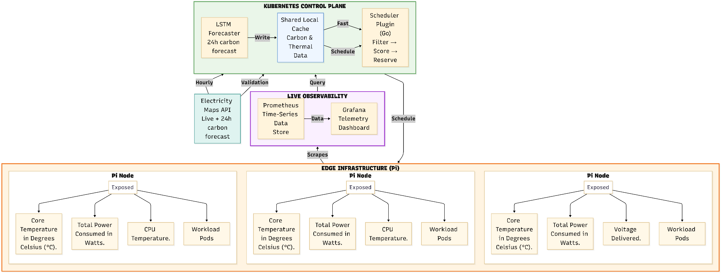
METHODOLOGY
2
3
5
4
1
Figure. System Architecture.

Slide 13
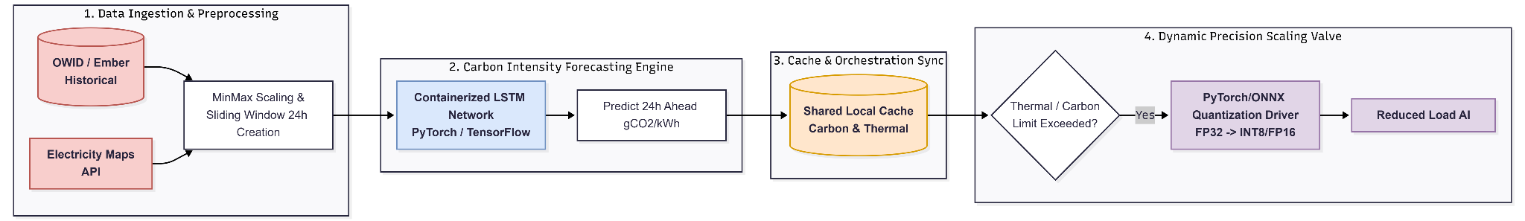
METHODOLOGY
5
6
Figure. AI/ML Pipeline.
2
3
5
1. Data Ingestion & Preprocessing: Merges historical datasets (OWID/Ember) with live, hourly API feeds (Electricity Maps). The data is normalized using MinMax Scaling and chunked into "24-Hour Sliding Windows" for the neural network.
2. The Long Short-Term Memory (LSTM): A LSTM network processes the time-series windows to generate a highly accurate prediction of regional carbon intensity (gCO2/kWh) for the next 24 hours.
3. Sync & Storage: Predictions are pushed to a Shared Local Cache. This decouples the AI from the orchestrator, allowing the Kubernetes Scheduler to read the data instantly without recalculating.
4. The Safety Valve: A parallel controller continuously monitors the cache. If grid carbon or hardware temperature thresholds are breached, it triggers a Quantization Driver to automatically downgrade AI compute precision and cut power.
4
1

Slide 14
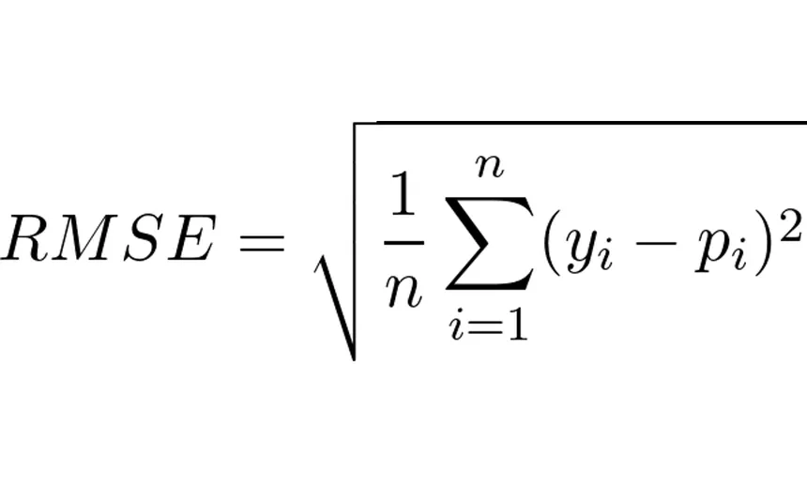
PERFORMANCE EVALUATION PLAN
Carbon Reduction Efficiency (CRE)
Is the energy utilized actually cleaner?
Measures the percentage decrease in carbon emissions achieved by the proposed scheduler compared to a standard baseline scheduler
Root Mean Square Error (RMSE)
Is the forecast accurate?
Calculates the Root Mean Square Error to evaluate the forecasting accuracy to verify how closely the LSTM's 24-hour carbon predictions match the actual live API data feeds.
Scheduler Overhead Latency
Does the scheduler add overhead?
Measures the execution time required for the Kubernetes scheduler plugin to read the cache, parse the forecast array, and assign pod placement

Slide 15
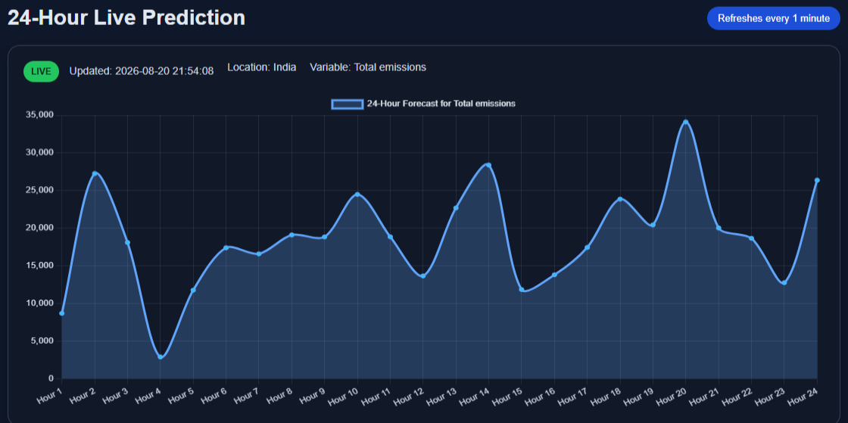
IMPLEMENTATION STATUS
This live dashboard visualizes the automated 24-hour grid forecasting engine, mapping out predicted national emissions for India across a rolling hourly timeline.

Slide 16
IMPORTANT EXPECTATIONS
1
FUNCTIONAL PROTOTYPE
We expect to deliver a working system by the final review. This includes a tested on physical edge (the Raspberry Pi K3s) cluster, deployed Custom Go Scheduler, and a live observability dashboard successfully integrating external grid APIs with internal kernel-level telemetry.
2
ACADEMIC CONTRIBUTION
We expect to improve our thermal-carbon scheduler to outperform existing modern standard Kubernetes schedulers in net emissions. Ultimately, we aim to produce a publication-ready report highlighting our novel approach to "Sustainable Computing".

Slide 17
REFERENCES
Primary Research Papers:
[1] T. Sukprasert, A. Souza, N. Bashir, D. Irwin, and P. Shenoy,“On the Limitations of Carbon-Aware Temporal and Spatial Workload Shifting in the Cloud,” in Proc. 19th European Conf. Computer Systems (EuroSys), Athens, Greece, 2024, pp. 924–941, doi: 10.1145/3627703.3650079.
[2] G. Zhang, W. Guo, Z. Tan, C. Sun, and H. Jiang, “CarbonEdge: Carbon-Aware Deep Learning Inference Framework for Sustainable Edge Computing,” in Proc. IEEE Int. Wireless Communications and Mobile Computing Conf. (IWCMC), 2026, pp. 445–450, doi: 10.1109/IWCMC69287.2026.11580067.
[3] H. Zhou, H. Y. Chan, S. Y. Zhang, M. Lin, and J. Ni, “A Kubernetes Custom Scheduler Based on Reinforcement Learning for Compute-Intensive Pods,” 2026.

Slide 18
Thank You

